Slide 1
U.S. Marriage and Divorce Rates by State
Matthew yurich, Madhusudan tamrakar, Allison dorion

Slide 2
Data Sources
CDC National Vital Statistics Report - Marriage Rates
CDC National Vital Statistics Report – Divorce Rates
CDC National Vital Statistics Report – Marriage and Divorce Rates per 1,000 of Total Population

Slide 3
Back End Development
Data Cleaning
Database Set Up

Slide 4
Front End Development
Marriage Rates App
Divorce Rates App

Slide 5

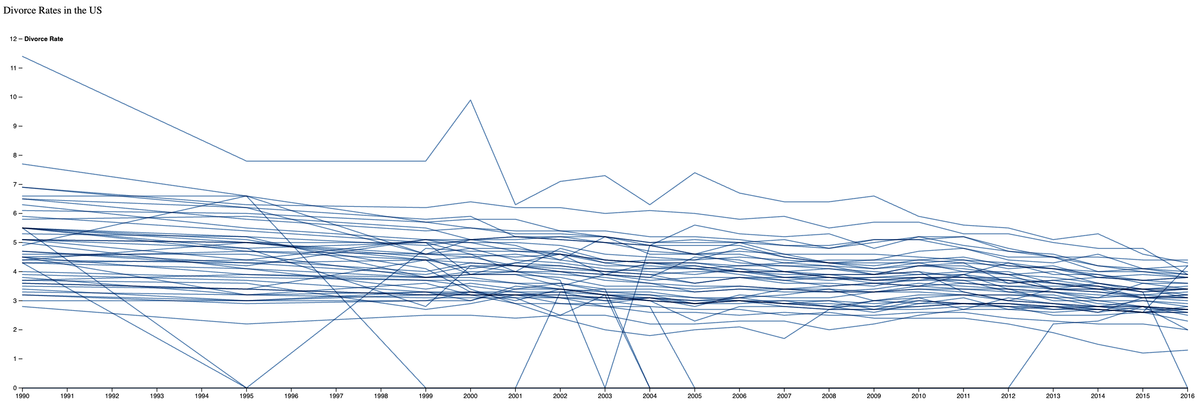
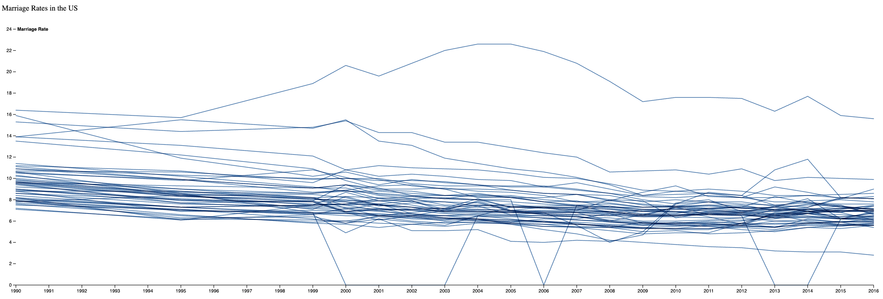
Overview

Slide 6
Questions?

